Slide 1

6th Grade Math
Unit 3, Lesson 6 Solving Two Step, Real-World Problems with Fractions or Decimals – Part 1 Volume 1, pg. 116

Slide 2


Benchmark
MA.6.NSO.2.3
Solve multi-step, real-world problems involving any of the four operations with positive multi-digit decimals or positive fractions, including mixed numbers.
volume 1, pg. 116

Slide 3
Integrated Mathematical Thinking and Reasoning Standards
MA.K12.MTR.3.1 Complete tasks with mathematical fluency.
MA.K12.MTR.7.1 Apply mathematics to real-world contexts.
volume 1, pg. 116

Slide 4

Learning Targets
I can solve two-step, real-world problems involving any of the four operations with decimals.
I can solve two-step, real-world problems involving any of the four operations with fractions.
volume 1, pg. 116

Slide 5

Warm-Up
volume 1, pg. 117

Slide 6
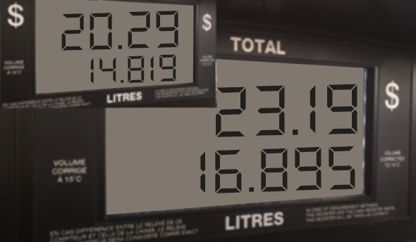

3.6.1 Warm-Up: Gas Guzzler
The image below shows the cost of $14.819$ and $16.895$ liters of gasoline.
What is the price per liter of gas?
How much will it cost to pump $38$ liters of fuel into the tank?
volume 1, pg. 117

Slide 7

Guided Practice
volume 1, pg. 117

Slide 8

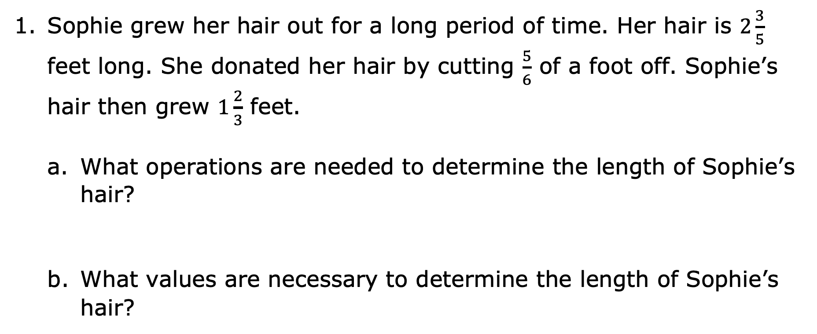
3.6.2 Guided Practice: Two-Step Rational Problems
Sophie grew her hair out for a long period of time. Her hair is $2\frac{3}{5}$ feet long. She donated her hair by cutting $\frac{5}{6}$ of a foot off. Sophie’s hair then grew $1\frac{2}{3}$ feet.
What operations are needed to determine the length of Sophie’s hair?
What values are necessary to determine the length of Sophie’s hair?
volume 1, pg. 117

Slide 9
Write the numeric expression that can be used to determine the length of Sophie’s hair.
Determine the length of Sophie’s hair.
Determine if the length of Sophie’s hair makes sense. Support your answer.
volume 1, pg. 117

Slide 10
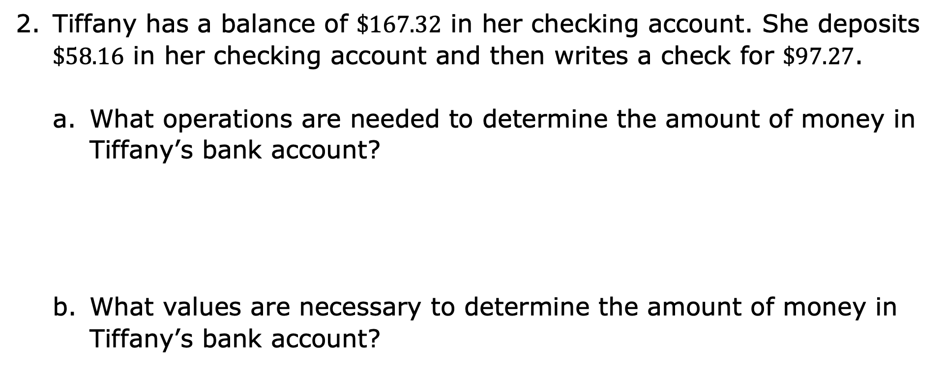
Tiffany has a balance of $\$167.32$ in her checking account. She deposits $\$58.16$ in her checking account and then writes a check for $\$97.27$.
What operations are needed to determine the amount of money in Tiffany’s bank account?
What values are necessary to determine the amount of money in Tiffany’s bank account?
volume 1, pg. 118

Slide 11
Write the numeric expression that can be used to determine the amount of money in Tiffany’s bank account.
Determine the amount of money Tiffany has left in her checking account.
volume 1, pg. 118

Slide 12

Collaboration
volume 1, pg. 118

Slide 13

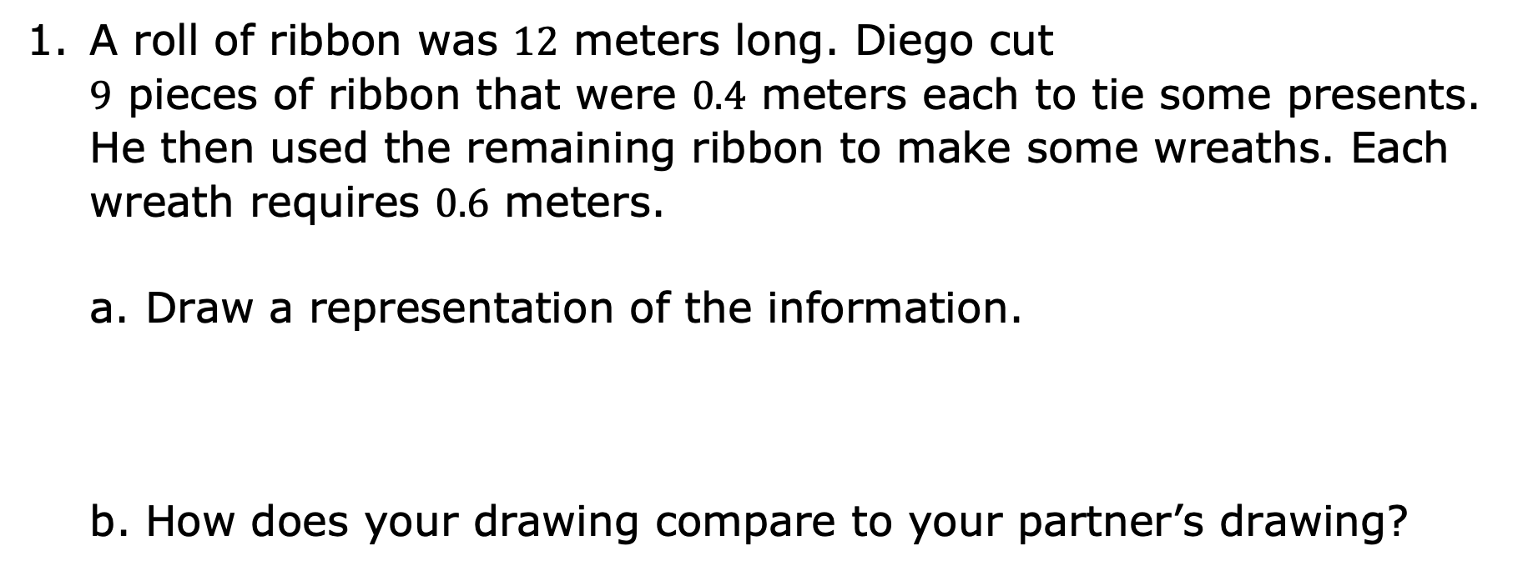
3.6.3 Collaboration: Problem Solving
A roll of ribbon was $12$ meters long. Diego cut $9$ pieces of ribbon that were $0.4$ meters each to tie some presents. He then used the remaining ribbon to make some wreaths. Each wreath requires $0.6$ meters.
Draw a representation of the information.
How does your drawing compare to your partner’s drawing?
volume 1, pg. 118

Slide 14
Draw a circle around the piece of ribbon in your drawing that is available to make wreaths.
Write the numeric expression that can be used to determine the amount of ribbon, in meters, available for making wreaths.
How many meters of ribbon are available for making wreaths?
volume 1, pg. 118

Slide 15
What piece of information is not needed to determine the amount of ribbon available for making wreaths?
Write a question that uses this information.
volume 1, pg. 119

Slide 16

Wrap-Up
volume 1, pg. 119

Slide 17
3.6.4 Wrap-Up: Reflection
Place an X on the line to indicate your understanding of each of today’s learning targets. Then, provide a brief explanation or evidence to support your self-assessment.
I can solve real-world problems with two steps using decimals.
I can solve real-world problems with two steps using fractions.
I need help. I can’t get started. | I’m getting there. | I understand and have evidence.
I need help. I can’t get started. | I’m getting there. | I understand and have evidence.
volume 1, pg. 119

